Slide 1
Next-Generation Character Rendering Jorge Jimenez Javier von der Pahlen Technical Director Director of R&D Activision Blizzard Activision Blizzard

Slide 2
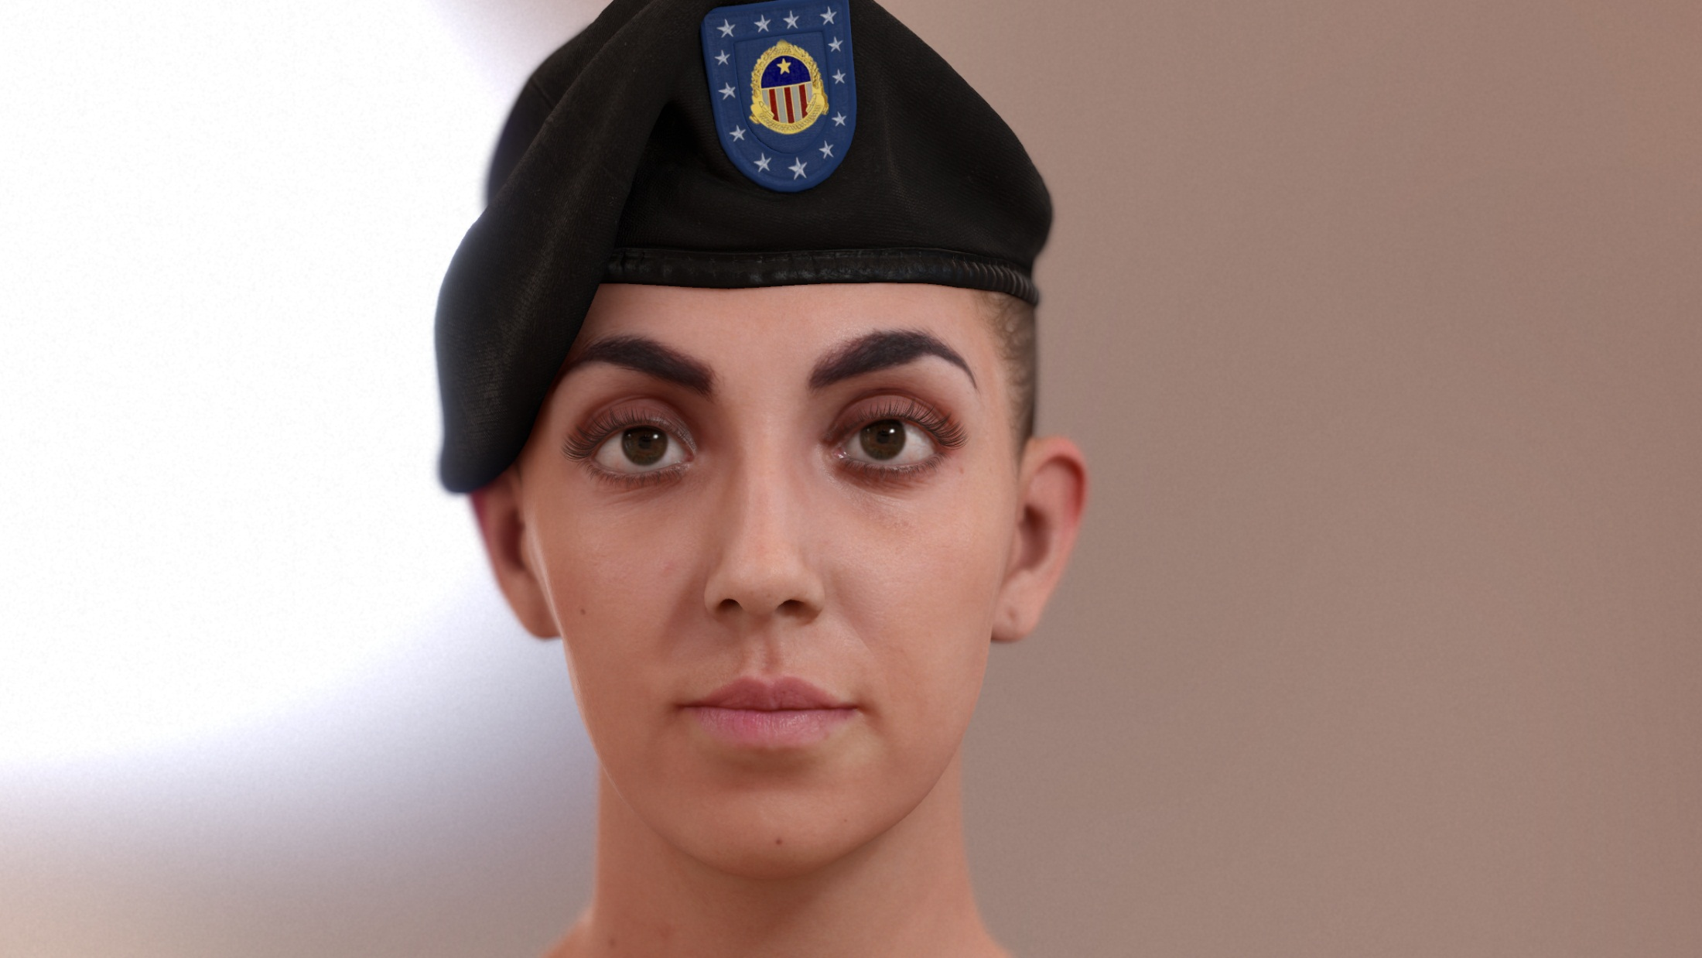
Notes:
Hi,
This presentation is all about the details,
and how very small things
can become crucial to bring characters to life
when they are put together.
Something I learnt these past years working with faces
is that each character rendering feature counts,
even if it seems to not make sense when used individually.

Slide 3

Disclaimer
Projectors don’t do justice to the details of our renderings.
This presentation reflects R&D that ATVI is exploring
This content is for presentation purposes only and does not reflect actual design examples or actual game assets.
The information in the presentation is not complete.
Notes:
First of all I’d like to mention that projectors don’t do justice to very detailed images.
Second, this presentation reflects what R&D is exploring
And the content of this presentation doesn’t reflect actual design examples or actual game assets.
Given the time limit for the talk, I’ll just give an overview of each topic.
I recommend you downloading the presentation for more information about the details.

Slide 4
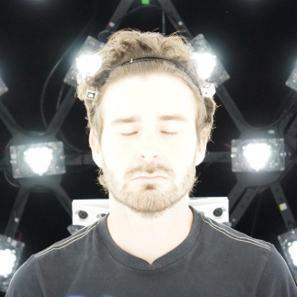
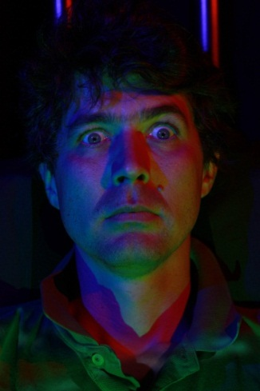




Jorge Jimenez
Graphics
R&D
Javier von der Pahlen
Director of R&D
Etienne
Danvoye
Technical Director
Bernardo
Antoniazzi
Technical Art Director
Zbyněk Kysela
Modeler and Texture Artist
Mike
Eheler
Programming & Support
Notes:
Here you have the full team,
with Javier Pahlen leading the research.

Slide 5
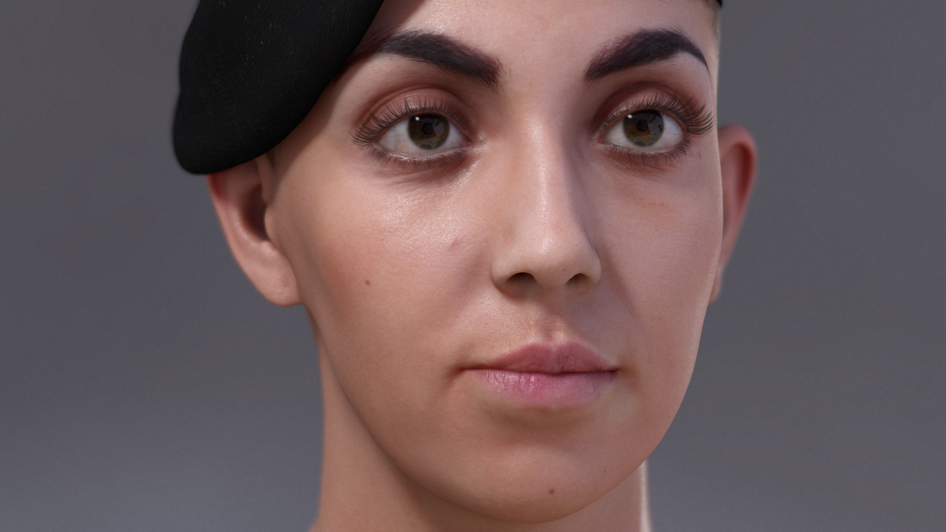
Notes:
So, let me present Lauren,
one of our testing characters,
running ONE EIGHTY frames per second.
There are many things important for character rendering.
For example, the modeling, the shadows, the eyelashes…

Slide 6
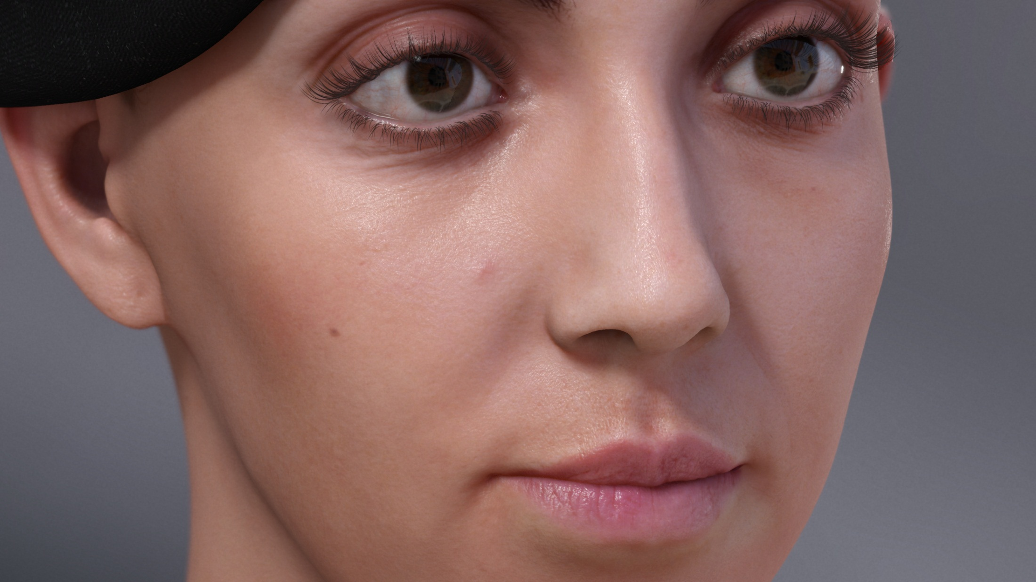
Notes:
…the specular reflections, the occlusion, the skin, post fx and of course…

Slide 7
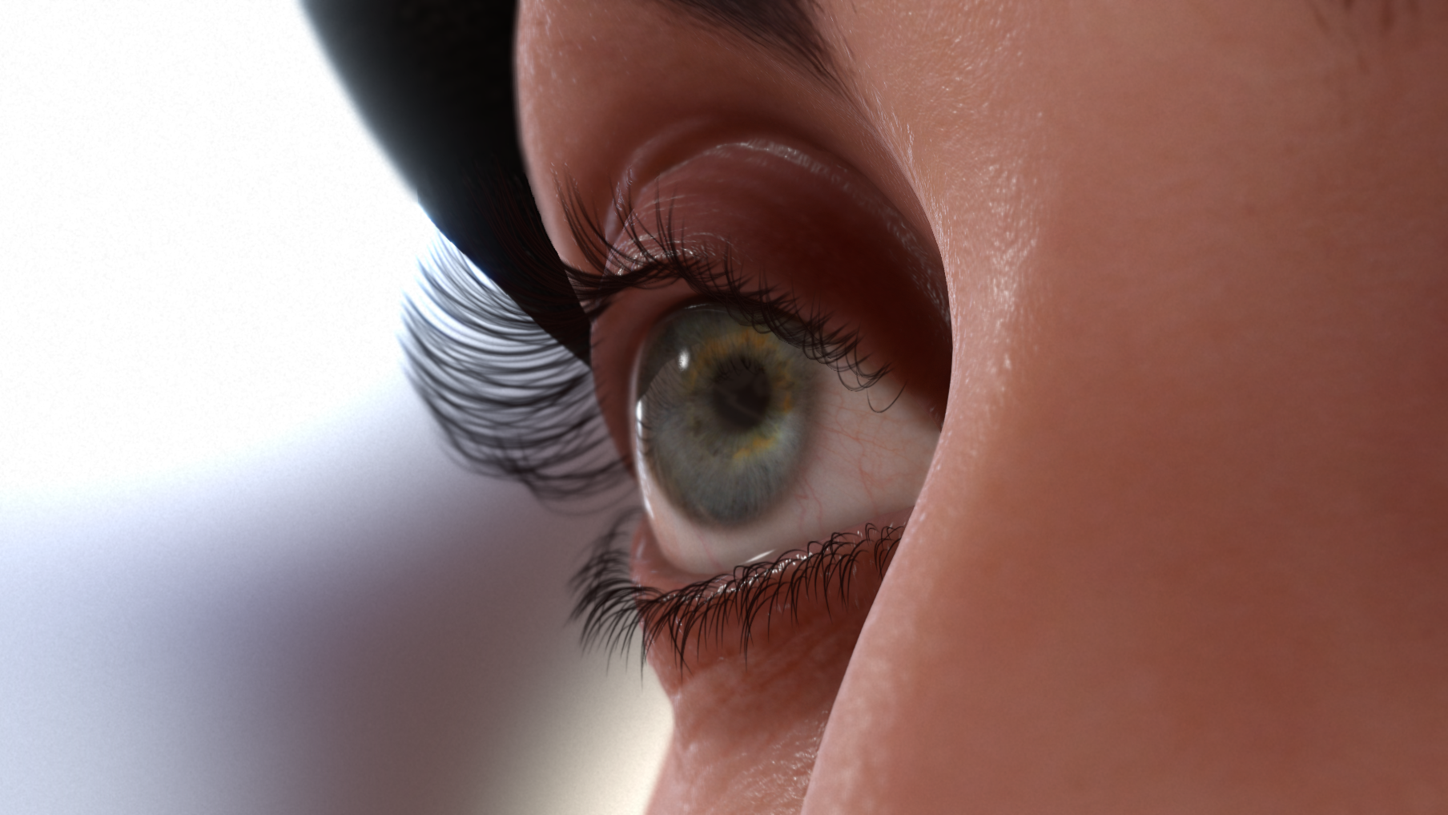
Notes:
the eyes, known to be windows to the soul, and for me, of extreme importance for showing emotions.
Notice that, to a certain degree, we manage to hold up the realism,
representing very fine skin details even at macro distances.

Slide 8
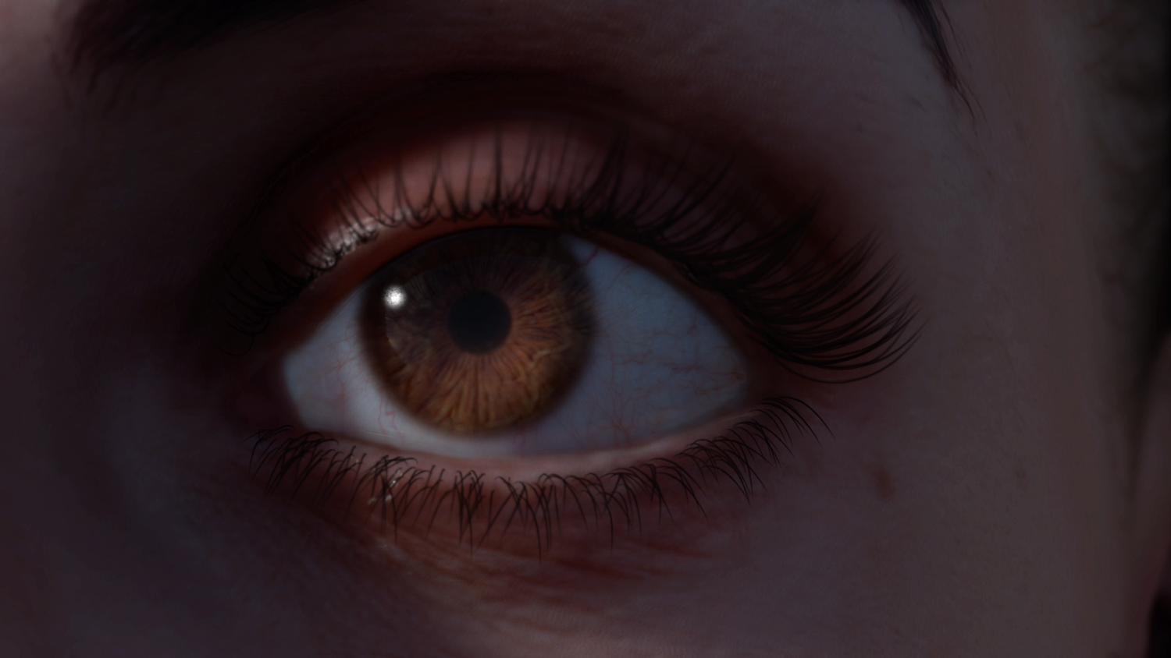
Notes:
Here you can see the light transport in the eyes,
including light refraction,
and the smooth colored shadows on the top of the eye,
produced by subsurface scattering.

Slide 9
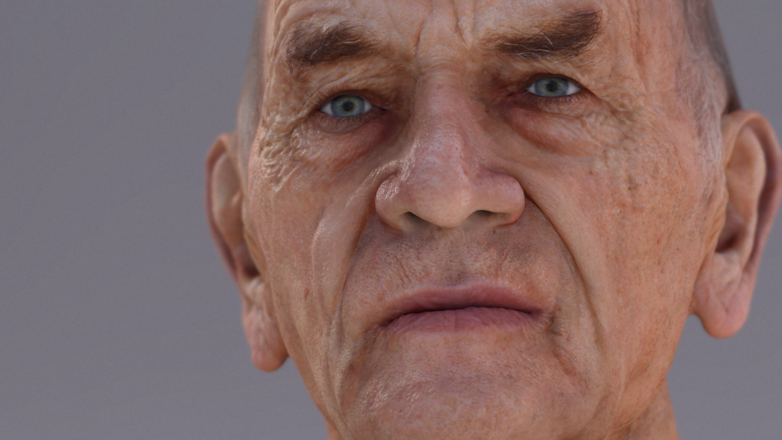
Notes:
In this one, you can see the power the eyes can have
for showing emotion.
The soft speculars of an old skin,
and the importance of depth of field in portrait shots.

Slide 10
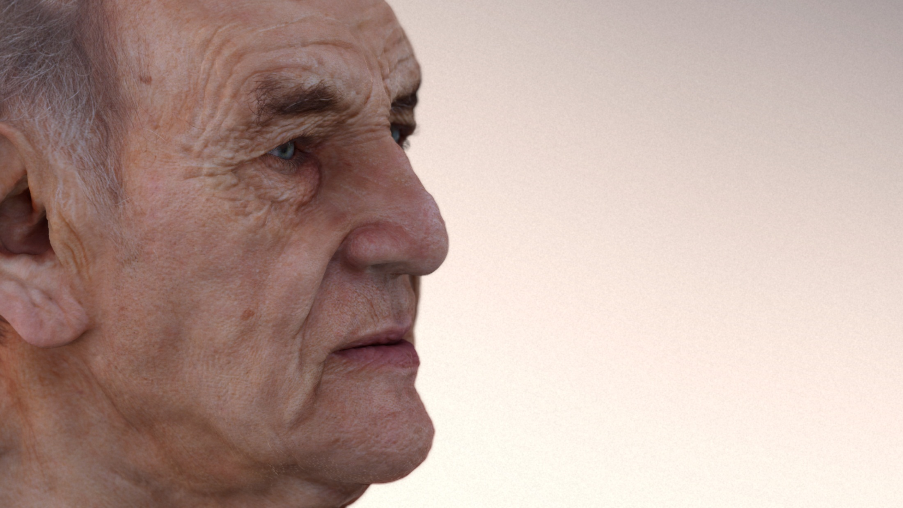
Notes:
This shows how soft lighting can reduce further the specularity of a face…

Slide 11
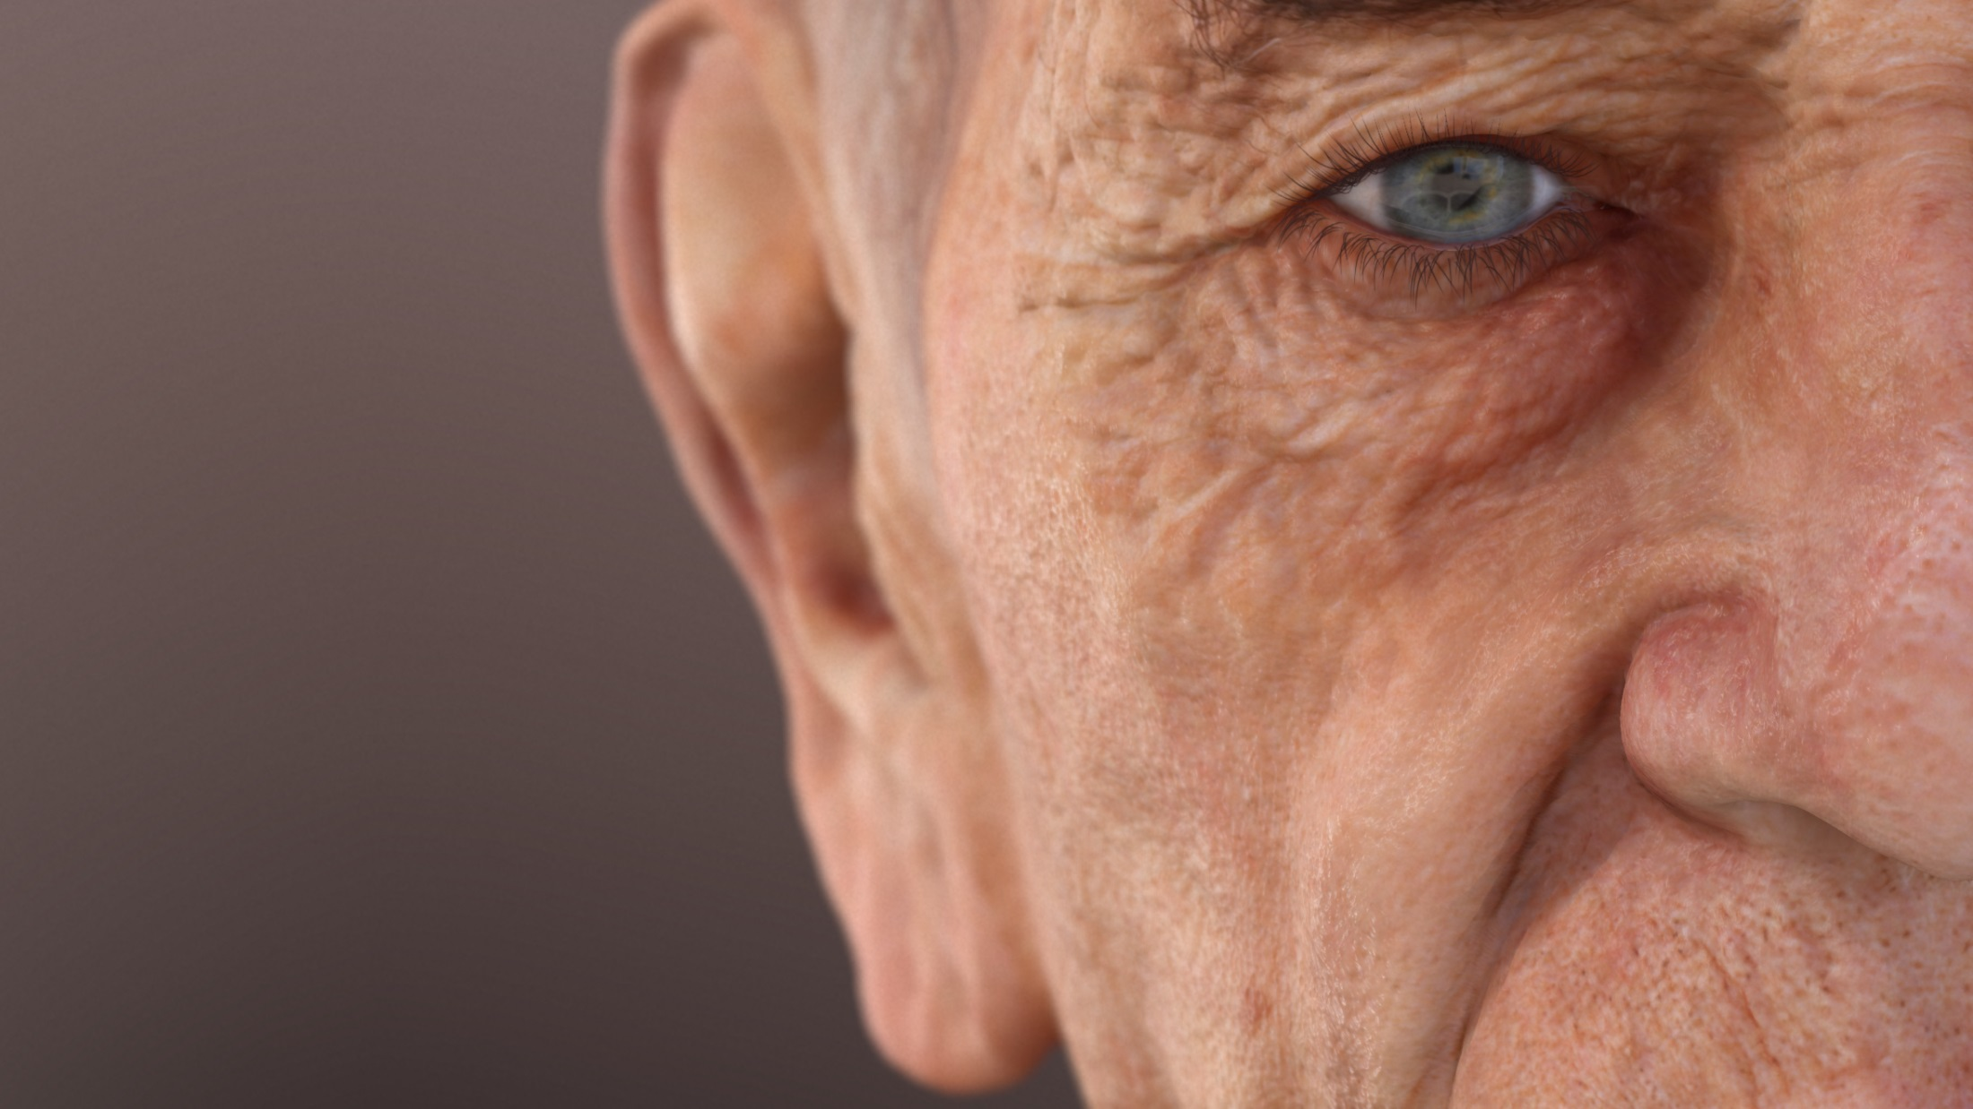
Notes:
…or how important the eyes can be in a composition.

Slide 12
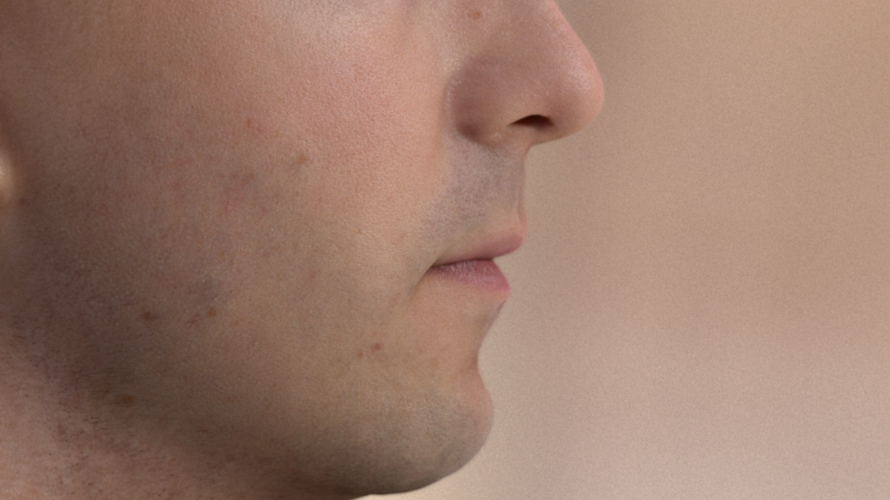
Notes:
See the soft diffuse lighting,
together with a strong specular bump,
and how film grain can add realism to a character shot.

Slide 13
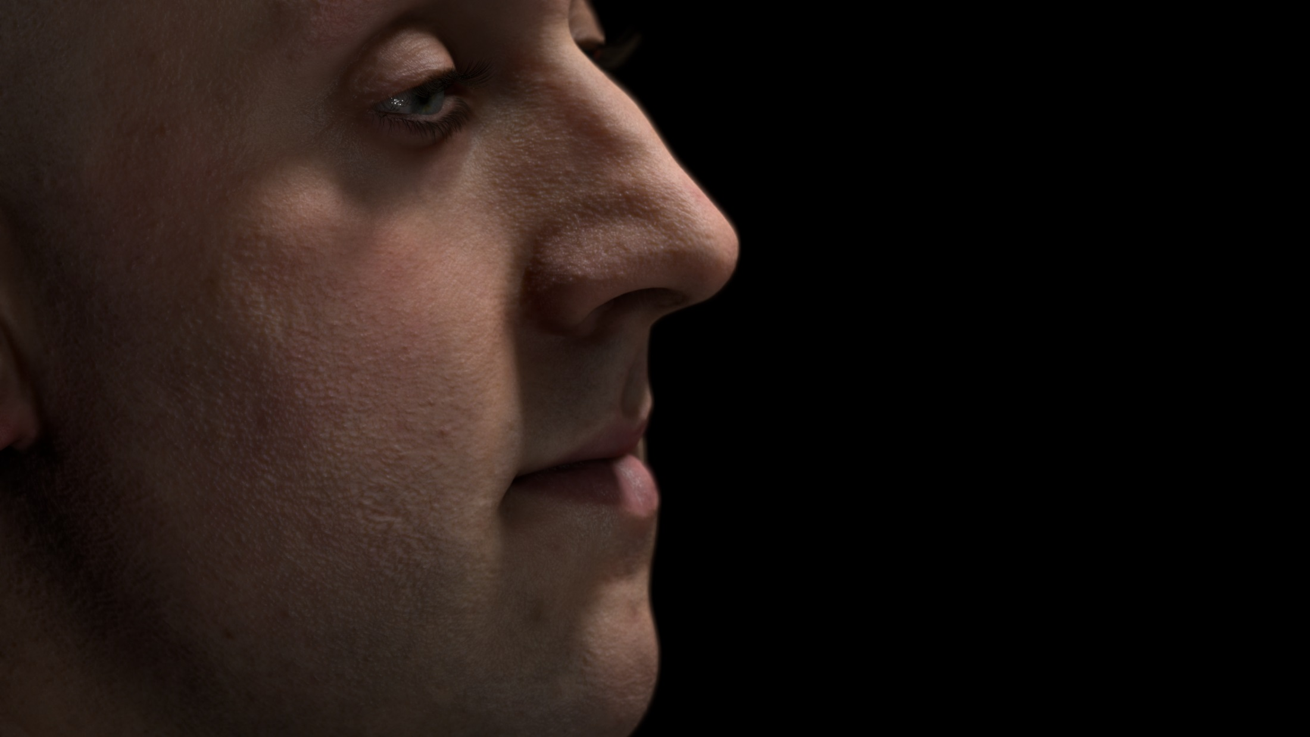
Notes:
There is much to say about this one.
Notice the strong bump on the nose,
and how smooth it looks like at the same time.
Achieving this is for me, one of the biggest challenges we faced.
Also look at the reflections of the eyes,
and how they reveal the how wet they are,
which in many times, reflect the character emotion.

Slide 14

Notes:
And last, but not least,
notice how the light is travelling through the nose of the character,
how light is refracting in the eyes,
and the subtle, yet noticeable pore detail in the face.

Slide 15
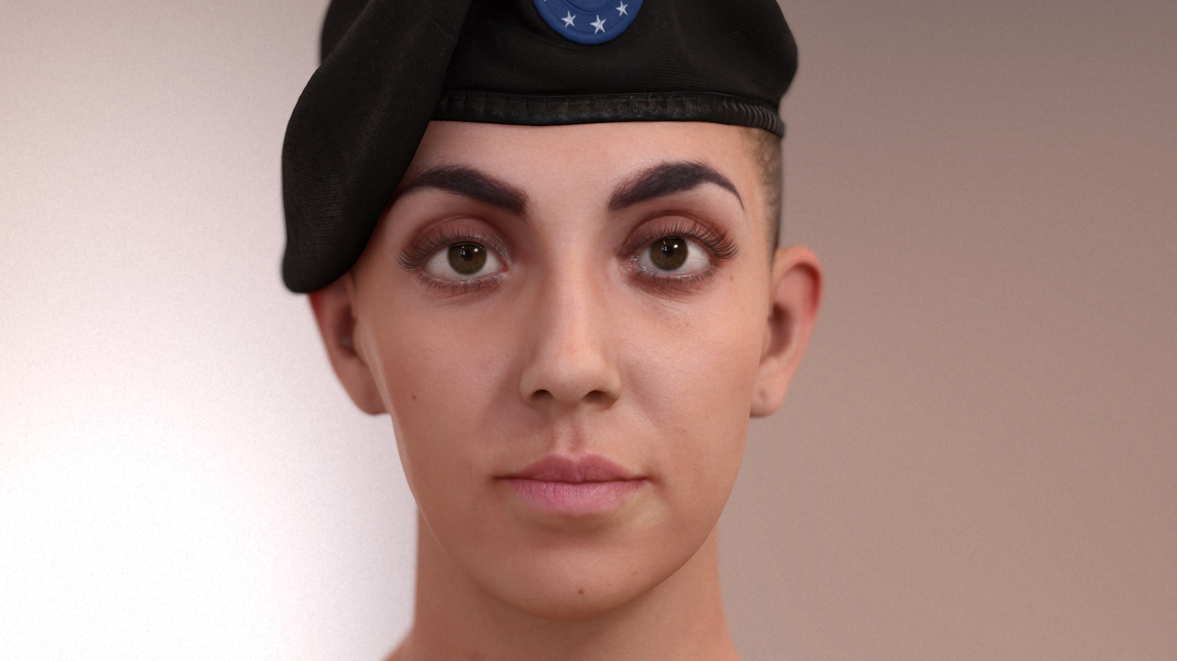
On
Notes:
I’m going to show you some images turning on and off
everything we do in special for character rendering.

Slide 16
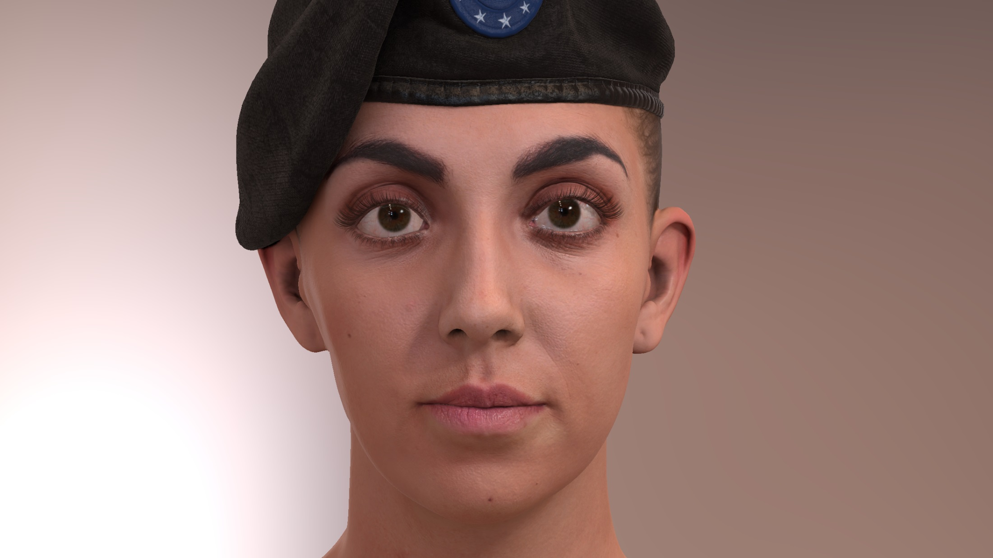
Off

Slide 17
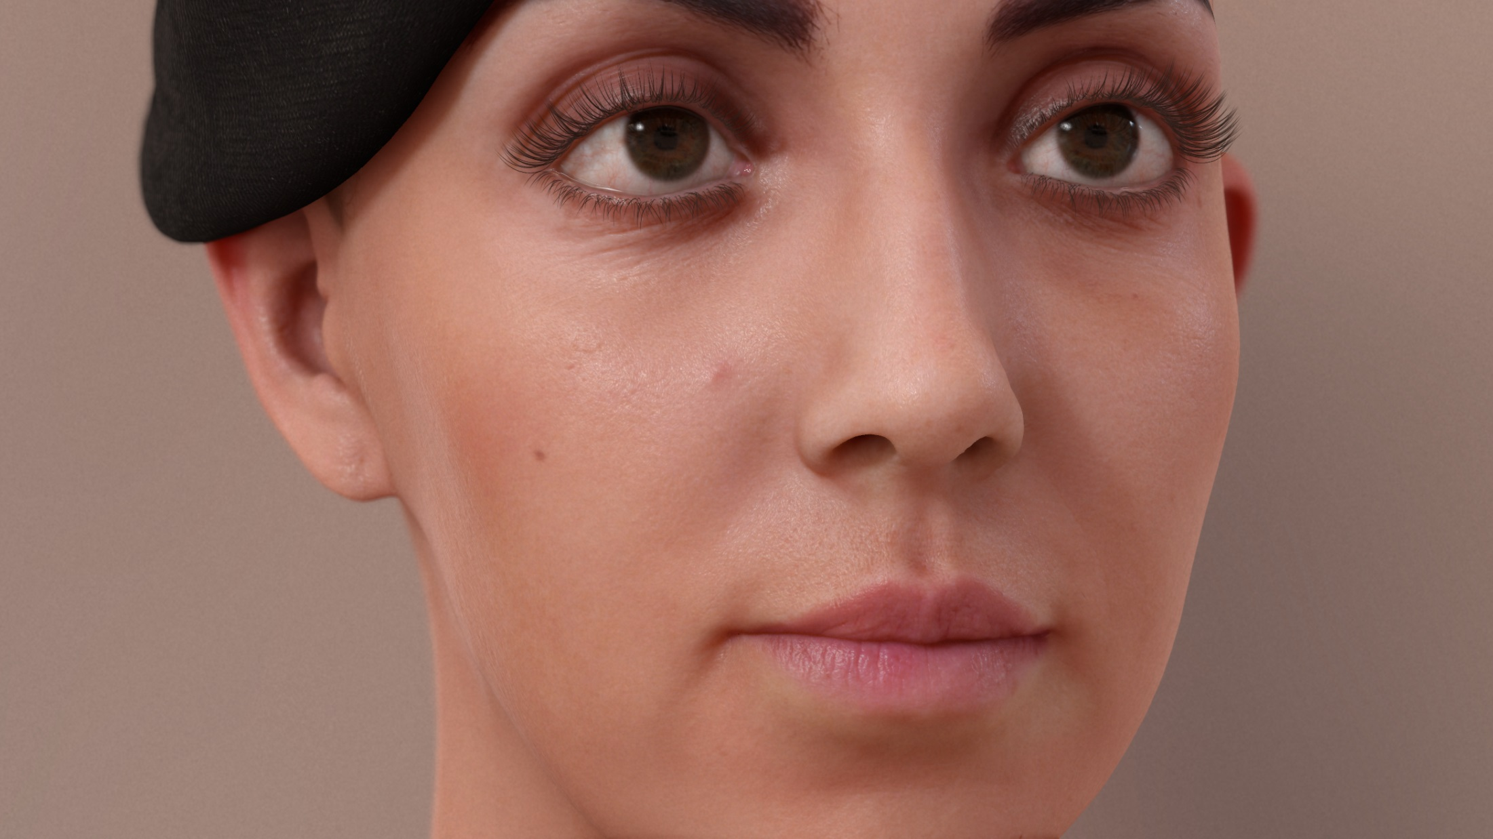
On
Notes:
Notice how the character turns into…

Slide 18
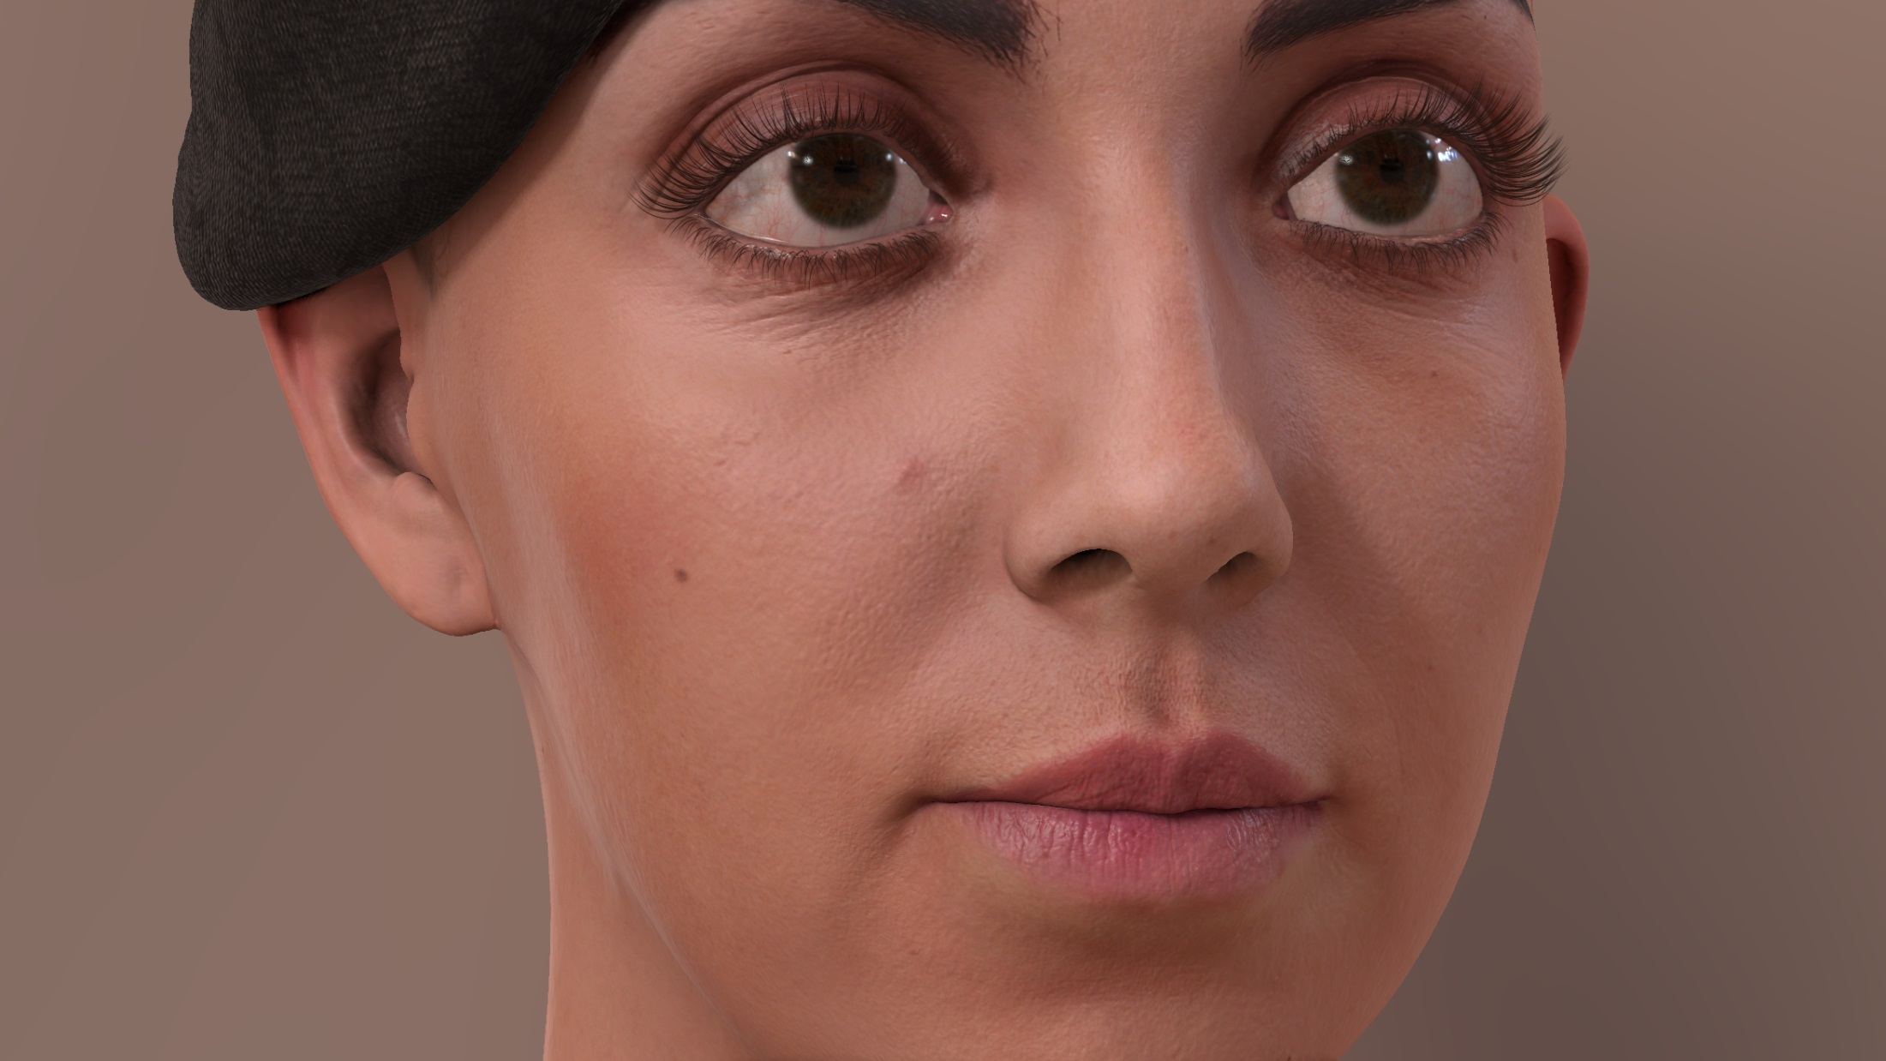
Off
Notes:
…a doll when we turn off our special rendering features.

Slide 19
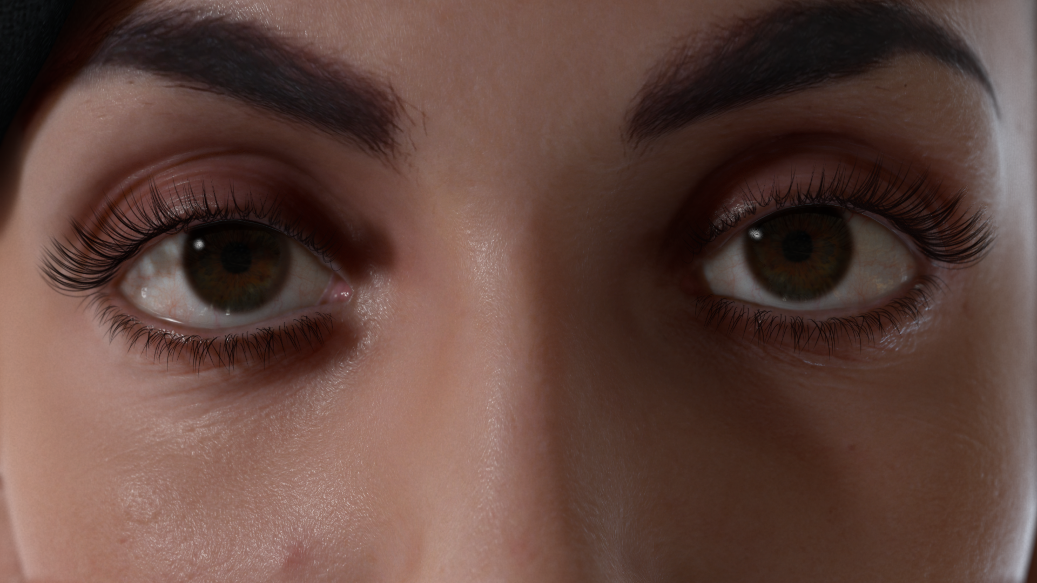
On
Notes:
They are specially important…

Slide 20
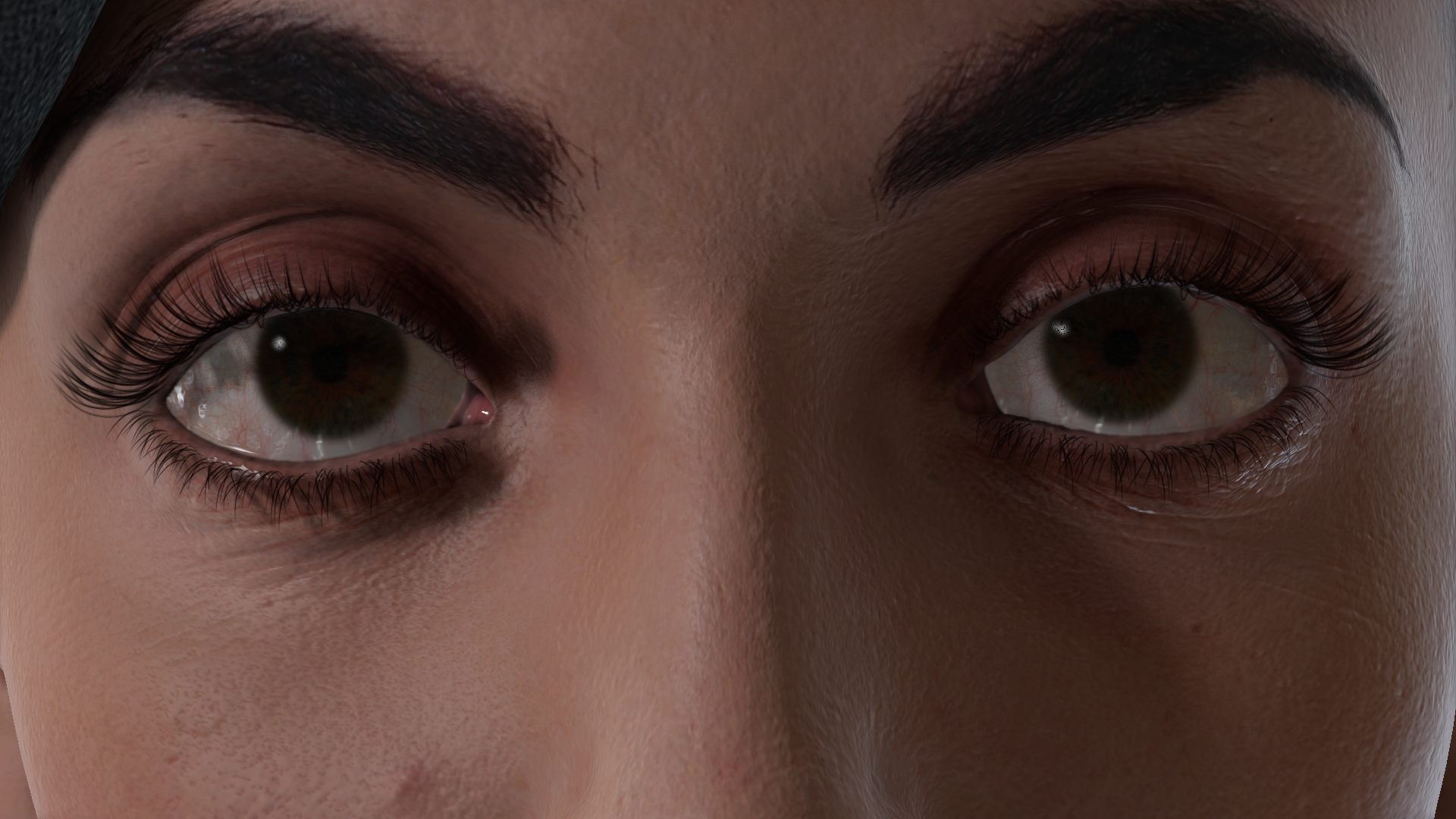
Off
Notes:
…the closer you are to the character.

Slide 21
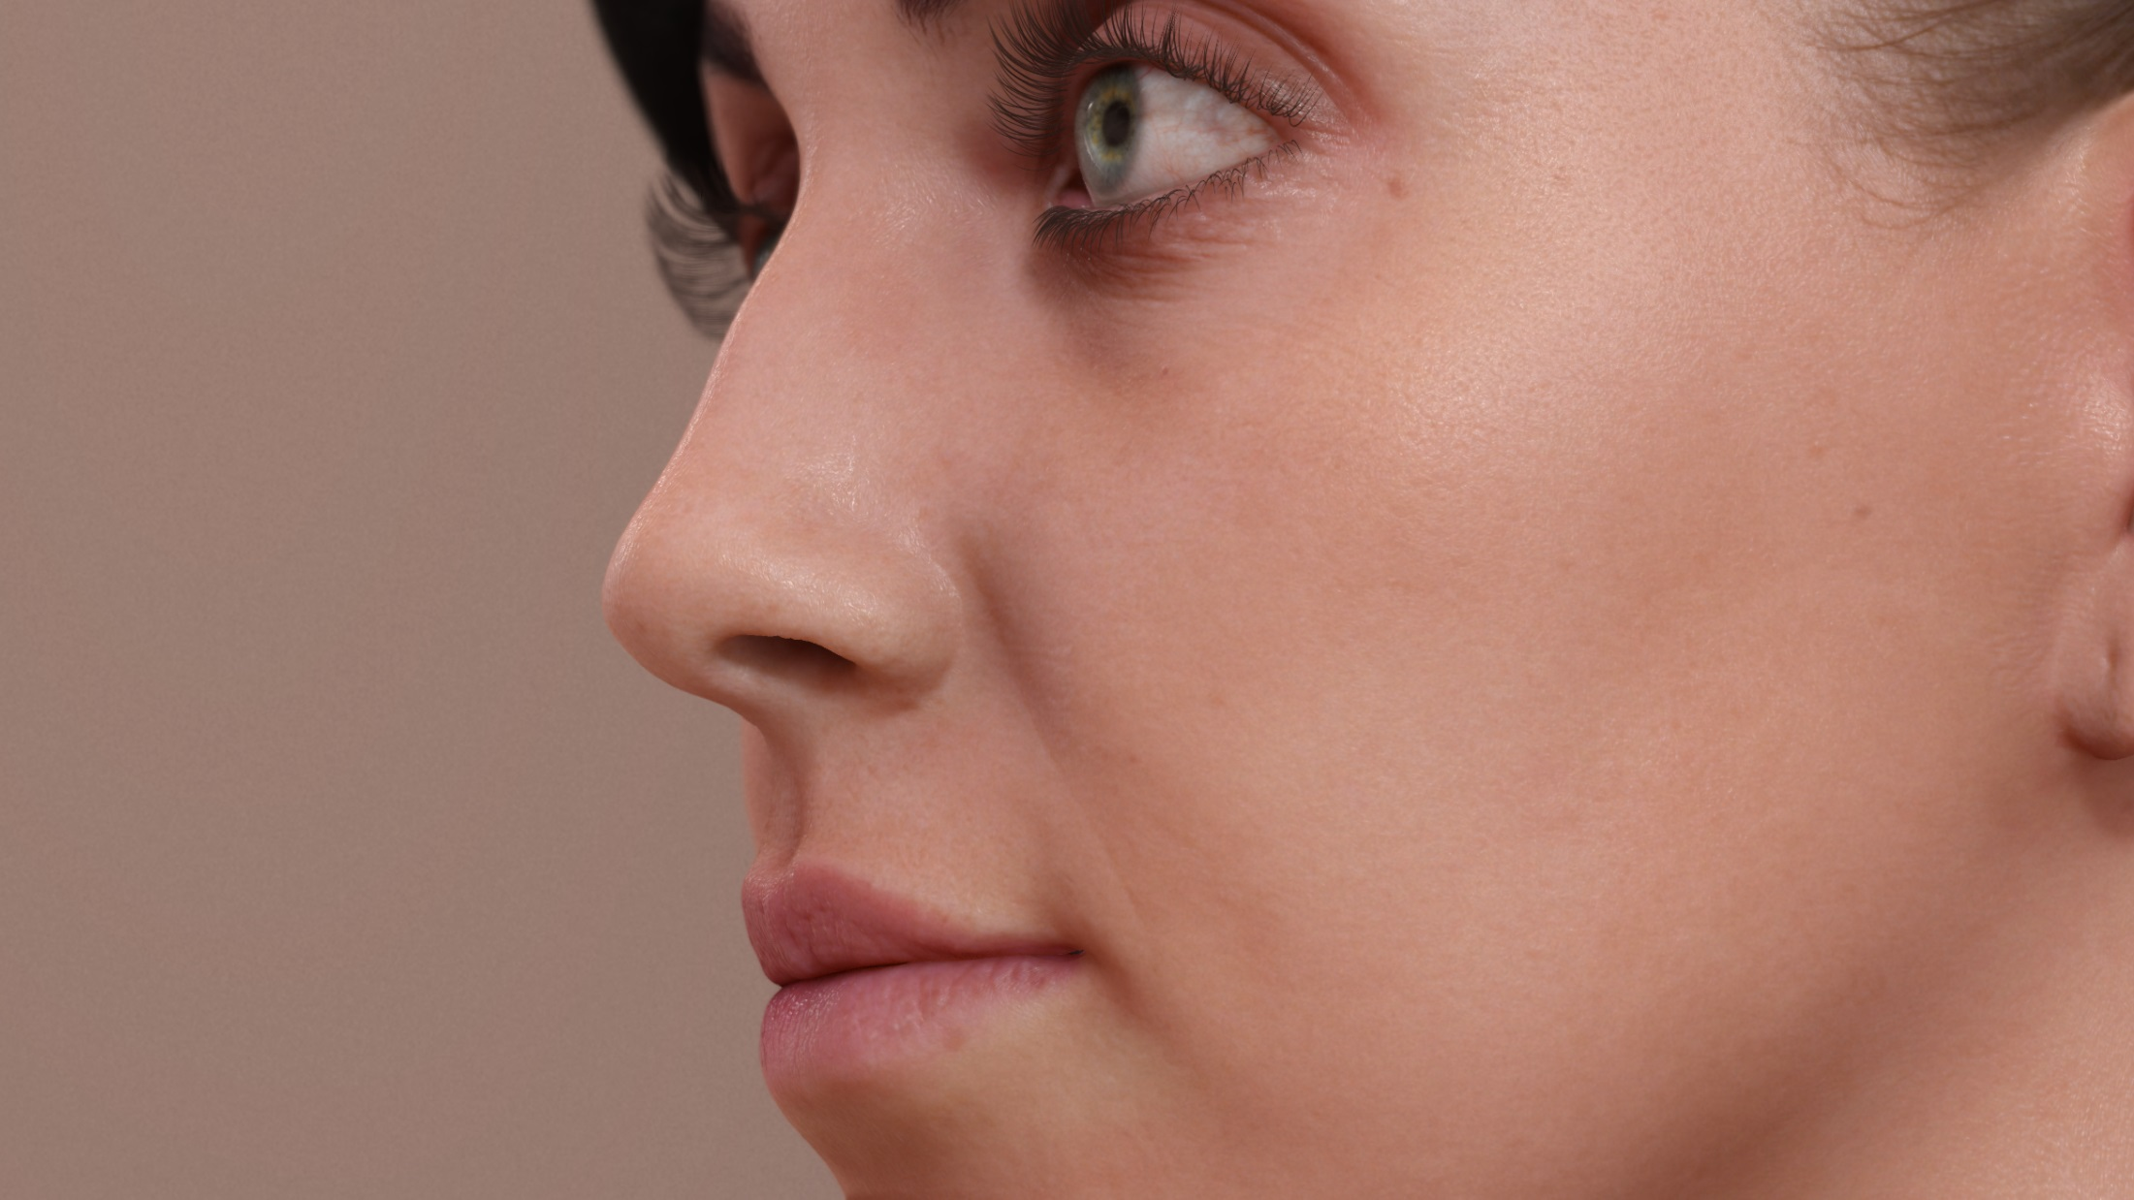
On
Notes:
Look at the refraction in the eyes…

Slide 22
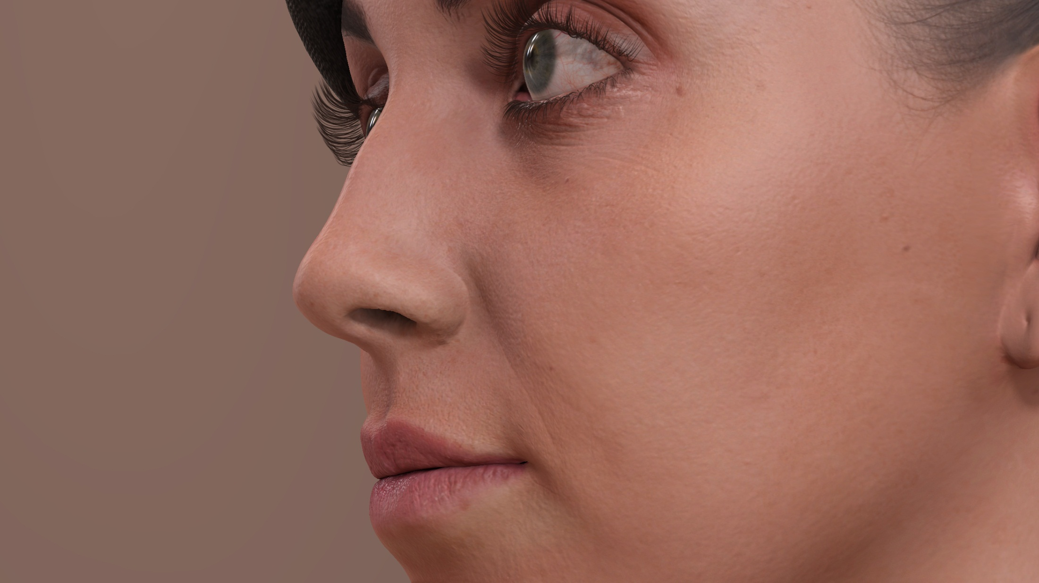
Off
Notes:
…and the specular details.

Slide 23
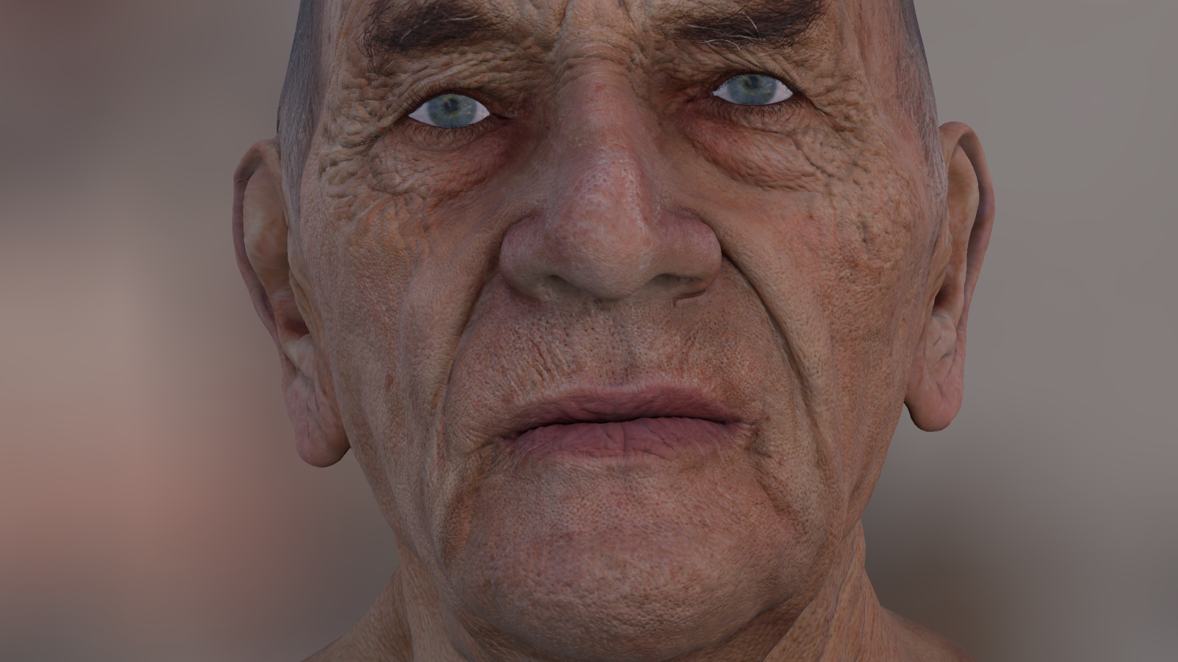
Off
Notes:
In my opinion,
this technology has the potential to take a current generation character…

Slide 24
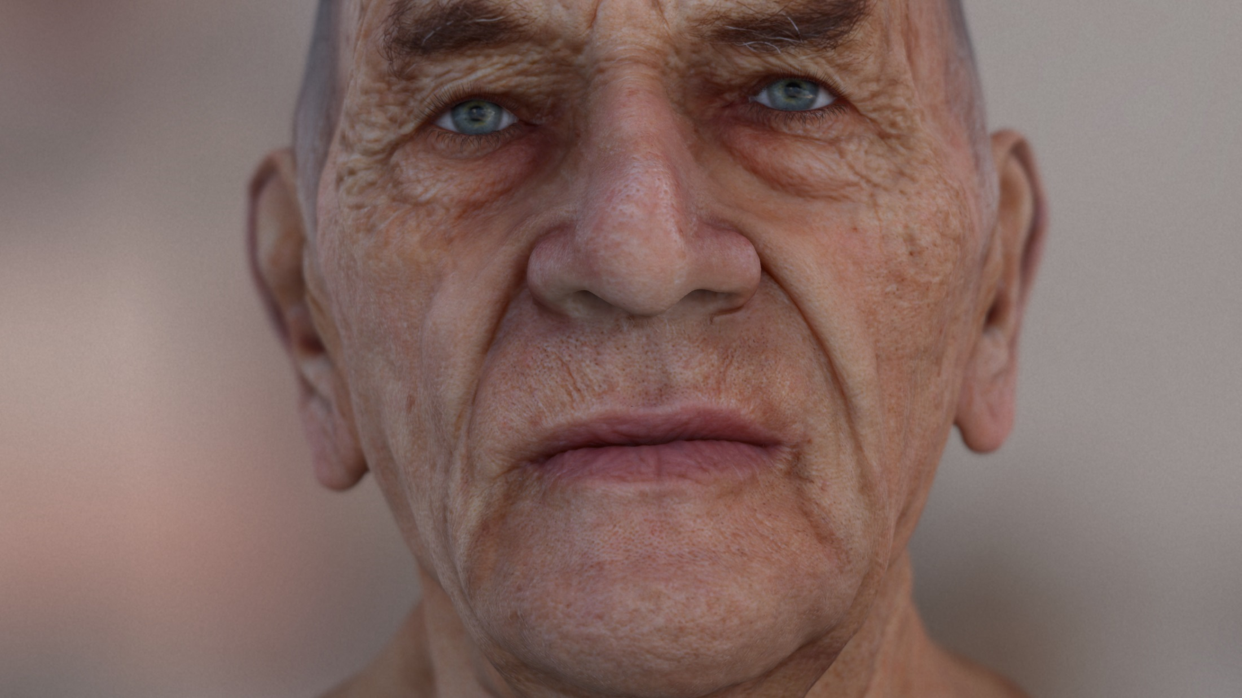
On
Notes:
…to the next generation life.

